Slide 1
Install Eneco Excel Tools
By Lorenzo

Slide 2
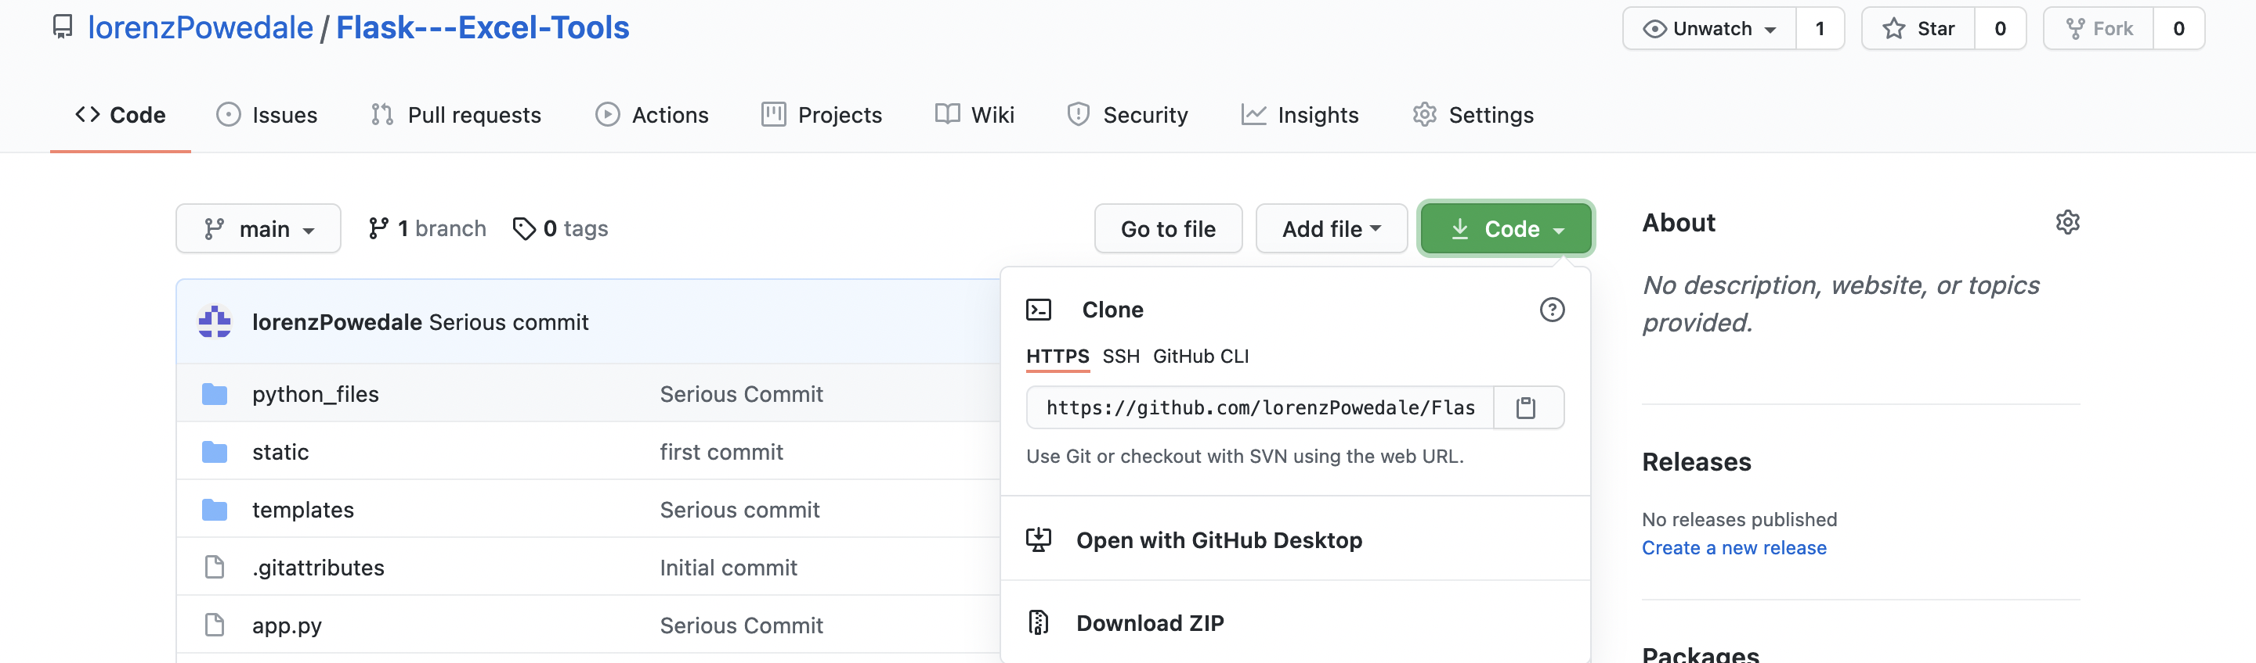
Download the Files
Go to: https://github.com/lorenzPowedale/Flask---Excel-Tools
Choose the „Download ZIP“ Option, and unzip the file

Slide 3
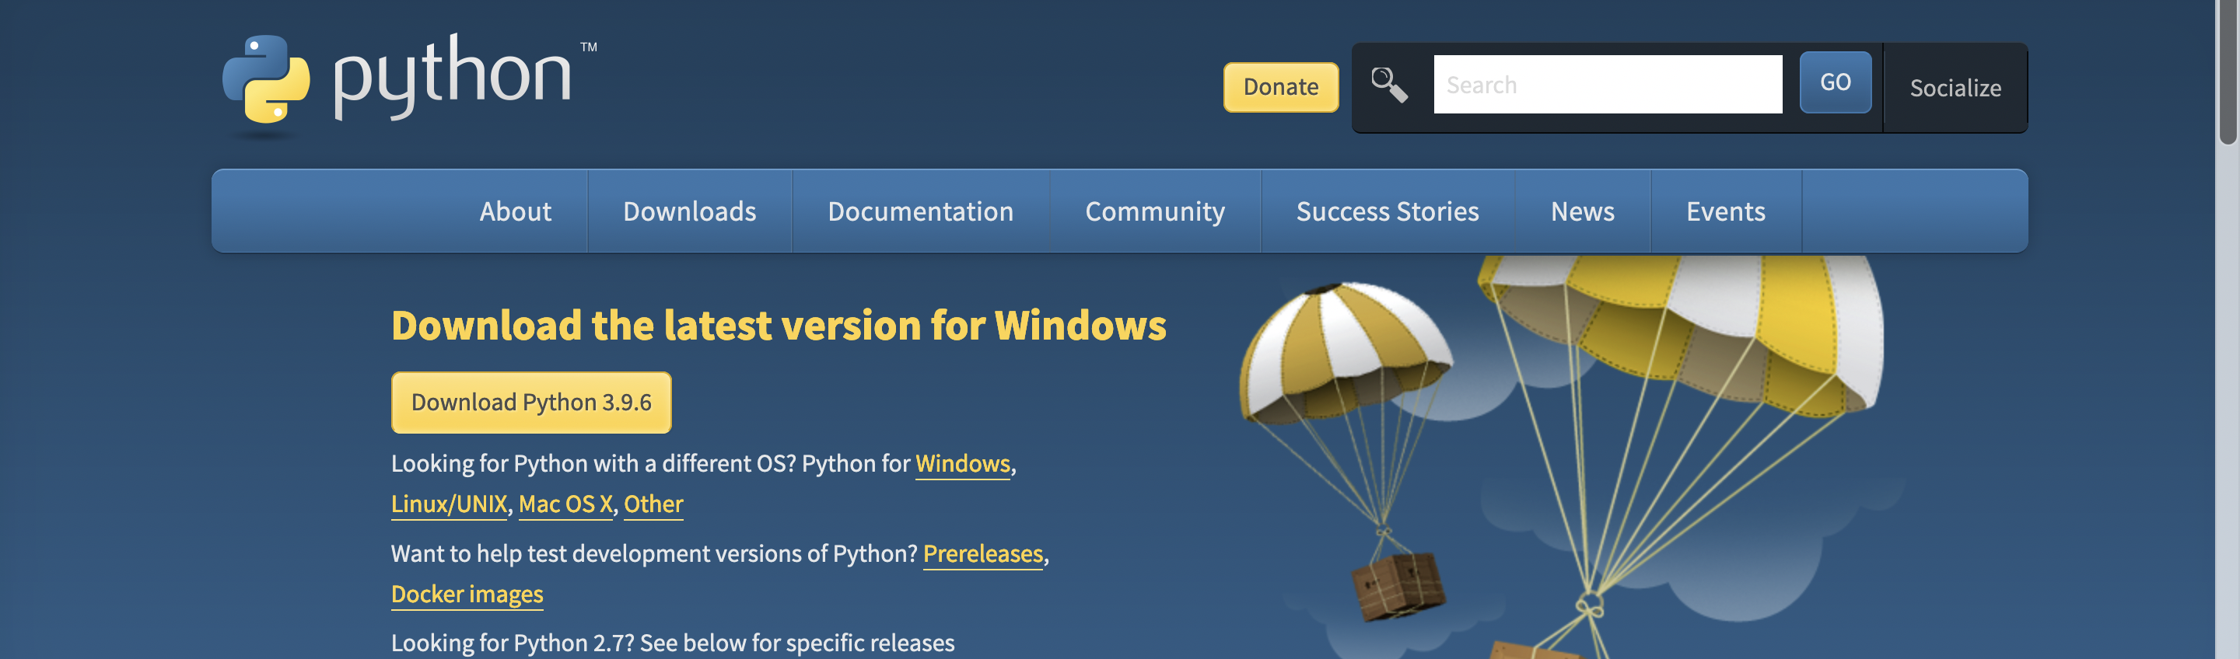
Install Python3(Windows)
Go to: https://www.python.org/downloads/
Press the yellow Download Button to download the file

Slide 4
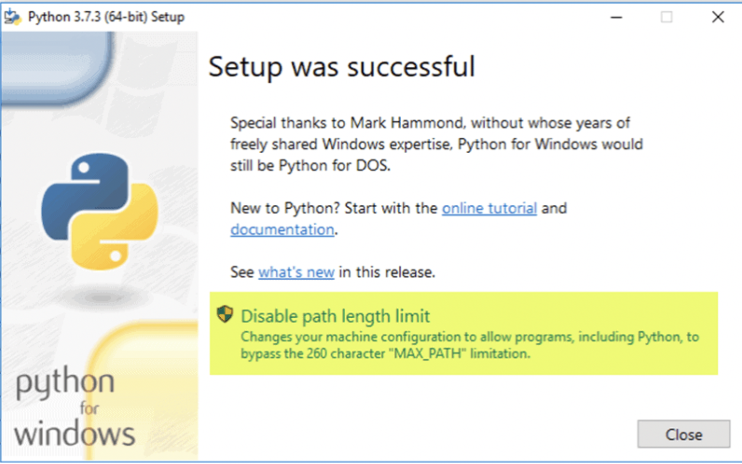
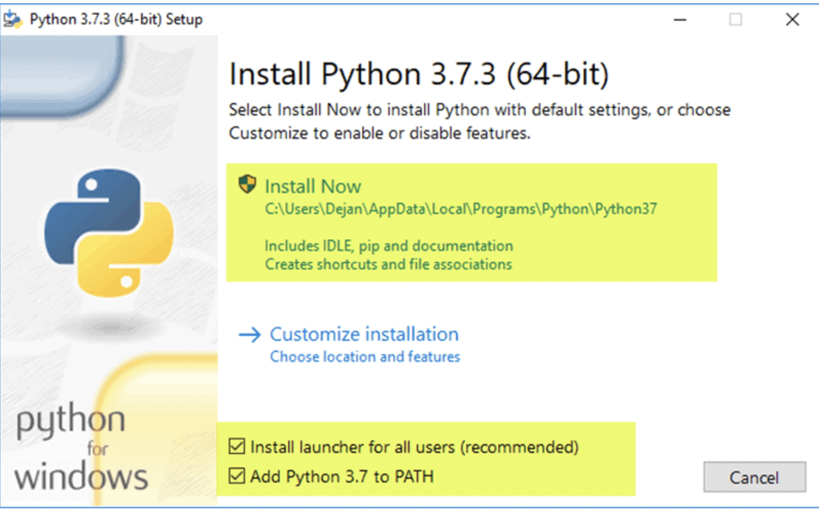
Install Python3(Windows)
Then run the .exe File you just downloaded
Make sure to have the same things checked as below( press Install Now and then press Disable path length limit)

Slide 5
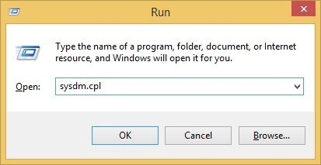
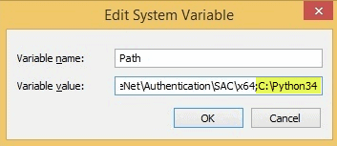
Add Python Path to Environment Variables(Windows)
1. Open the Start menu and start the Run app.
2. Type sysdm.cpl and click OK. This opens the System Properties window.
3. Navigate to the Advanced tab and select Environment Variables.
4. Under System Variables, find and select the Path variable.
5. Click Edit.
6. Select the Variable value field. Add the path to the python.exe file preceded with a semicolon (;). For example, in the image below, I have added ";C:\Python34."
7. Click OK and close all windows.

Slide 6
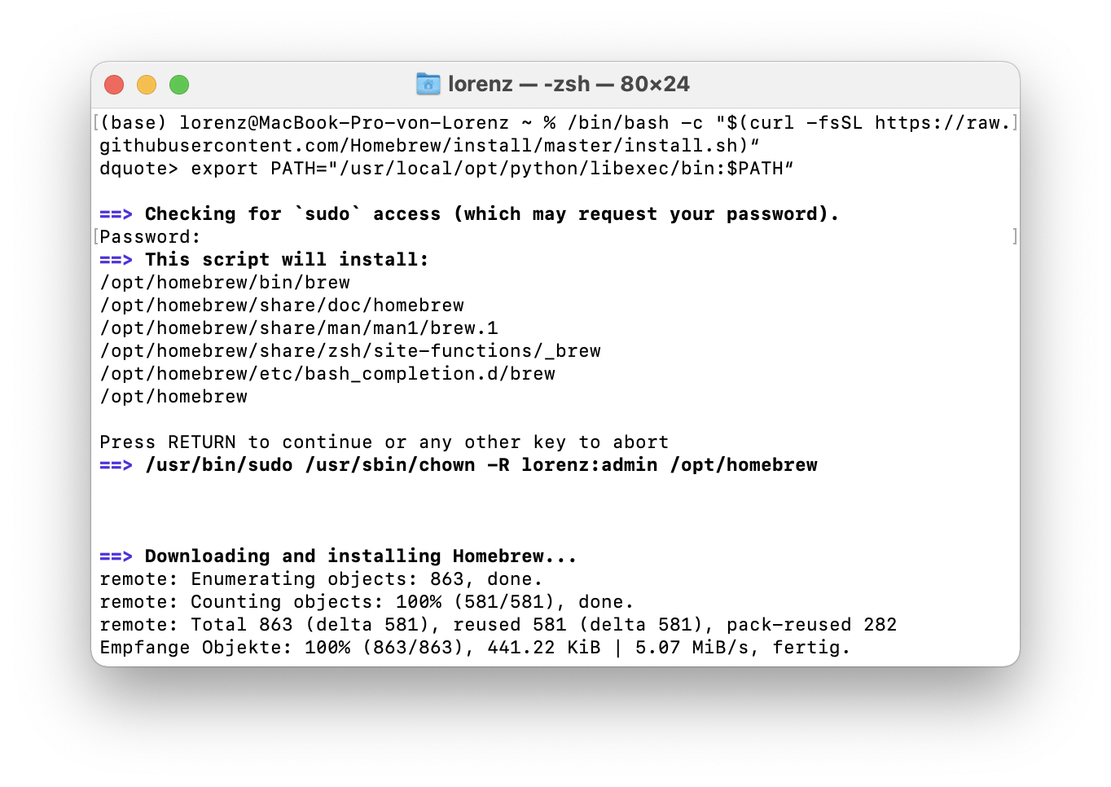
Install Python3(Mac)
Open a terminal and paste these commands in:
/bin/bash -c "$(curl -fsSL https://raw.githubusercontent.com/Homebrew/install/master/install.sh)“
export PATH="/usr/local/opt/python/libexec/bin:$PATH“
brew install python

Slide 7
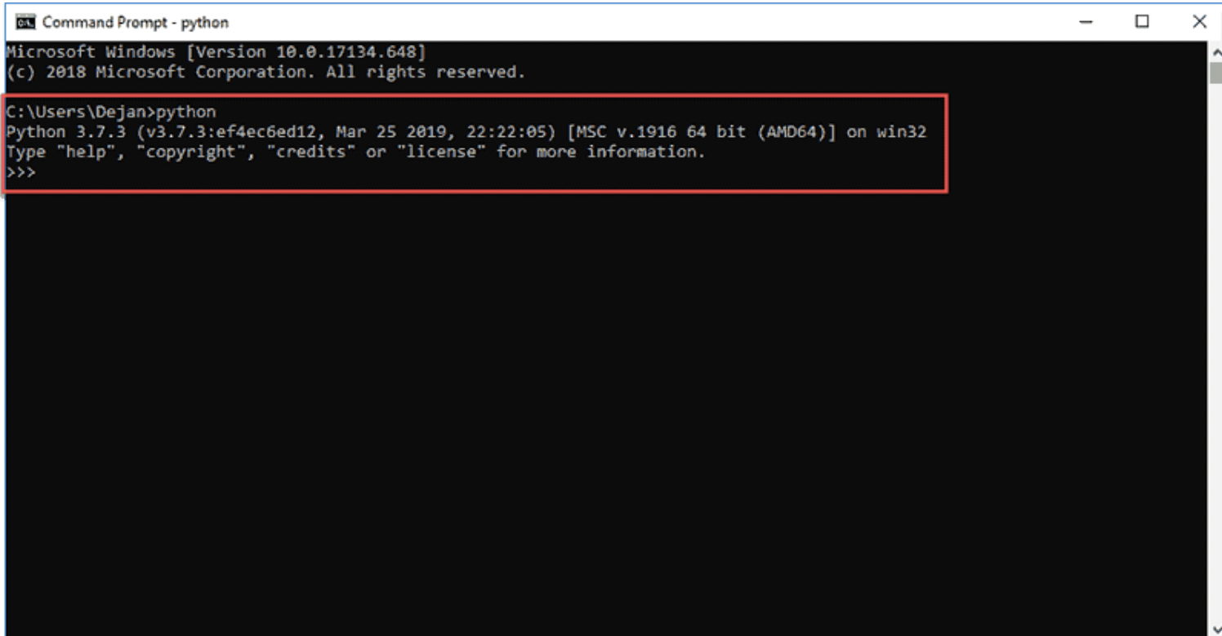
Check if Python is installed
Open a CMD Terminal (just search for cmd and open it) and check if python is installed by typing in „python“
It should look like this:

Slide 8
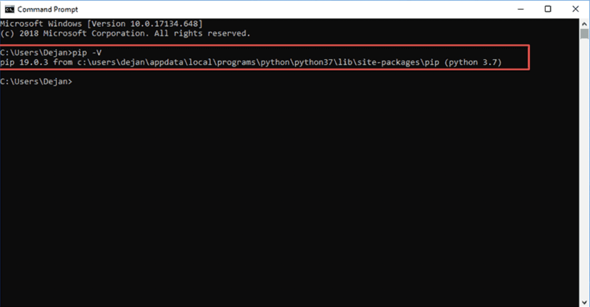
Check if PIP is installed
Open a CMD Terminal (just search for cmd and open it) and check if pip is installed by typing in „pip -V“
It should look like this:
(If something doesn’t work check the last slide)

Slide 9
Install dependencies
Open again a CMD Window and type in:
pip install openpyxl pandas unicodecsv pywebview

Slide 10
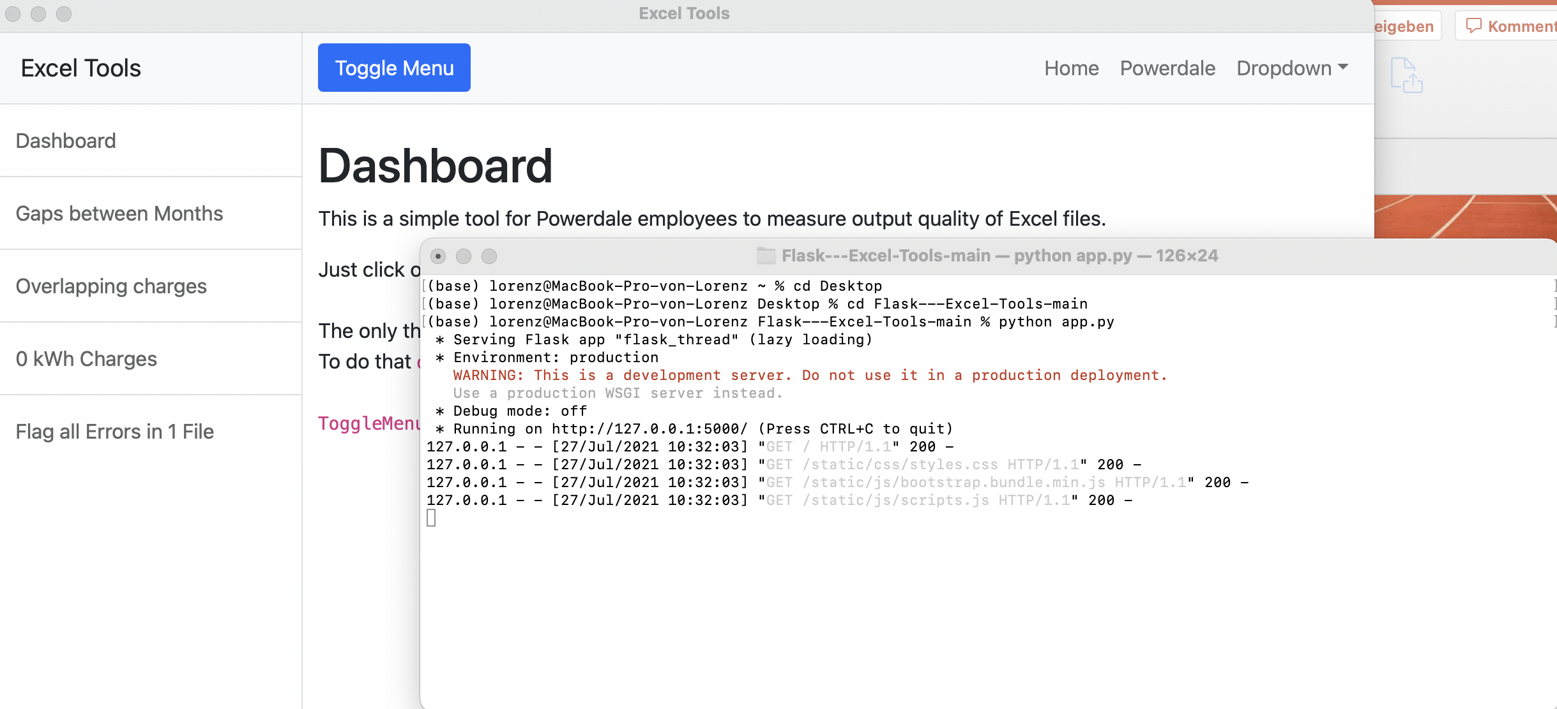
Run program
Navigate to the Folder you downloaded in the beginning(from GitHub)
Open CMD and type cd “{path to folder}” (e.g. cd C:/Flask---Excel-Tools-main)
Then type python app.py (If something doesn’t work check the next slide)

Slide 11
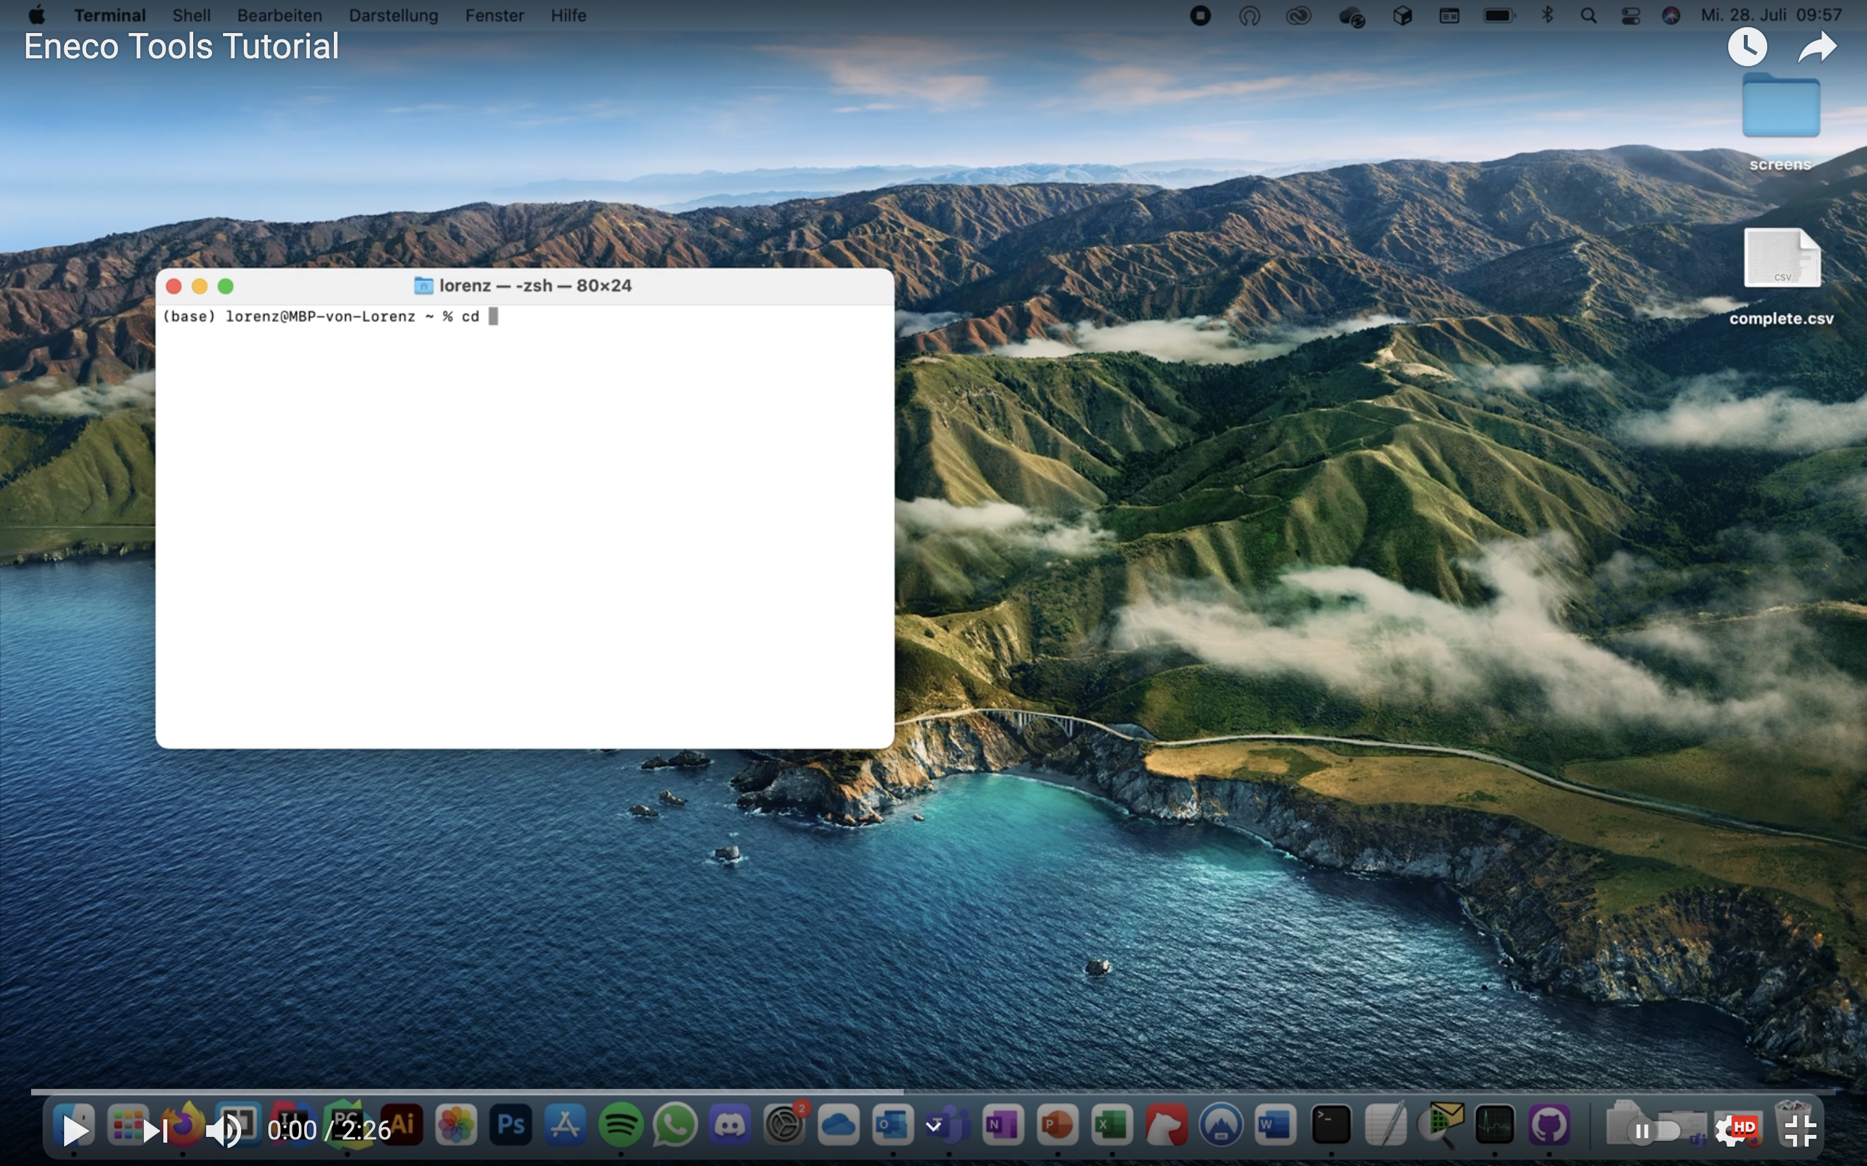
If everything worked but you‘re not sure how to use the tool
https://www.youtube.com/watch?v=ziYiXqUGozs

Slide 12
Errors
If you can‘t paste the Path in the window
start a WebBrowser (e.g. Google Chrome, Firefox, Edge etc.) and open the link http://localhost:5000
If pip –V doesn‘t work:
Download: https://bootstrap.pypa.io/get-pip.py
Go into the Download Folder and run: python get-pip.py

